Slide 1



AIRBUS AEROTHON 6.0 2024
AFNS
Advanced Flight Navigation System
PROTOTYPE SUBMISSION

Slide 2

OVERVIEW
01
02
03
Group Members &
Project theme
Problem Statement
Solution
04
05
06
Methodology &
Archietecture Diagram
Project Demostration
Wireframes

Slide 3


GROUP MEMBERS
Surupi Nandi
Pursuing a BS Degree from IIT Madras on Data Science and Apllications and a BTech degree at IEM Kolkata on CSE (AI & ML)
Nion Sarkar
Pursuing B.E in Civil Engineering from Jadavpur University
Varun K
Full Stack Developer at MBRDI Bangalore.
PROJECT THEME
Enhancing Flight Navigation Mechanism for Optimal Route Planning and Risk Mitigation

Slide 4

PROBLEM STATEMENT
In the domain of air travel, our goal is to efficiently connect any two airports while minimizing travel time. We have worked on a solution that generates all possible flight paths between two airports and recommends the fastest route. Airlines can customize routes by including or excluding specific airports. Our web application presents clear flight metrics data, weather updates, and visual travel paths to help make informed decisions.

Slide 5





SOLUTION
Flight Path Generation
Gathered real-life data from Kaggle and used available APIs
Detected all the possible flight routes available that connects two places
Path with the lowest travel time is named as the optimal path
Travel time is calculated based on the distance between the two places and the number of stopovers there are in the route.
Addressing the Problem
Dataset was not readily available, so we merged two datasets and did data preprocessing
Optimal route not only provides us with the shortest travel time, but also does real-time risk mitigation
There is a feature of including and excluding certain airports is there is any harsh weather or any political threat of air space closing and becoming a no fly zone
These impact metric helps the airline to take guided decision on the choice of flight path, and makes our solution effective and robust.

Slide 6

SOLUTION Continued
Technology Used
We have used SQLite, Python, Flask, Angluar
Algorithm used: Depth First Search
Assumptions & Reasoning
We have assumed the average cruising speed of commercial passenger aircraft to be 900 Km/hr (485.961 Knots), and the average time per stop-over is considered to be 2hr to calculate the total time for a particular route. We have chosen these numbers based on available data.
Implementation & Scalability
Our solution is simple to emplement and can be scaled to incorporate large databases. The solution provide the airline with all possible routes while taking constraints into consideration if any, and also suggests the optimal path based on total travel time, total distance, number of stopovers, weather and flight metrics

Slide 7




METHODOLOGY
DATASET & MODEL
FRONTEND
BACKEND
Merged two data sets based on Airport ID
Cleaned up Missing Data
Generated distance between source and destination using latitute and Longititude
Assumed a cruising speed and stop-over time to find total travel time
Used DFS Algo to generate path
Least travel time gave optimal path
Used D3.js to generate dynamic graph to represent the route sected
Used Angular for the frontend development
Used three.js for the login screen globe.
Generated APIs
Developed the backend using flask.
Used readily available APIs for some features.

Slide 8
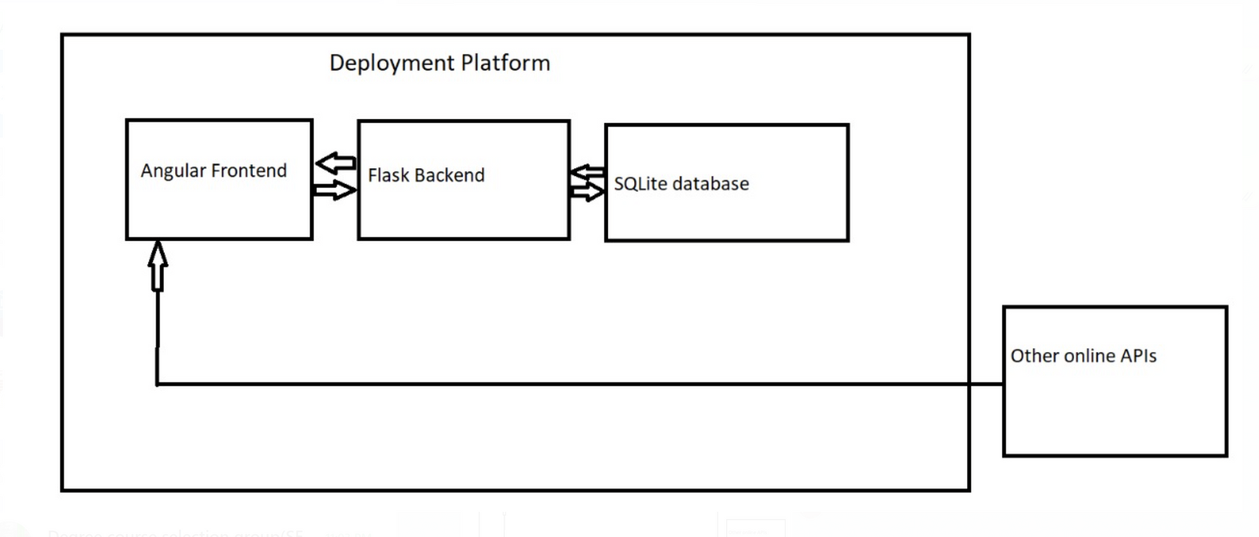
ARCHIETECTURE DIAGRAM

Slide 9

PROJECT DEMONSTRATION
Demo Video Link:
https://drive.google.com/file/d/1XqgG9vgzTIjQ3iFuO6r1ONZchzFhbC_J/view?usp=sharing
Links to Github:
https://github.com/varunk19/Frontend
https://github.com/varunk19/Backend

Slide 10
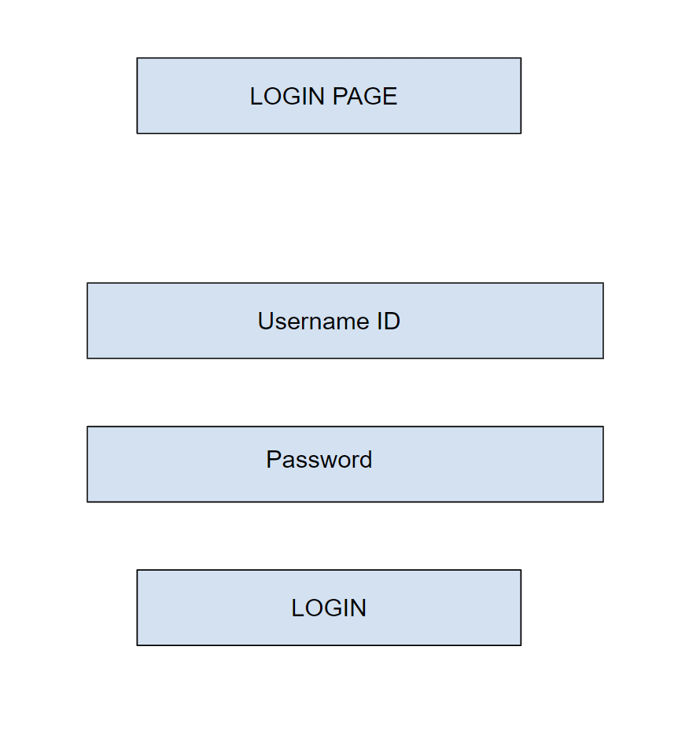
LOGIN PAGE
WIREFRAME

Slide 11
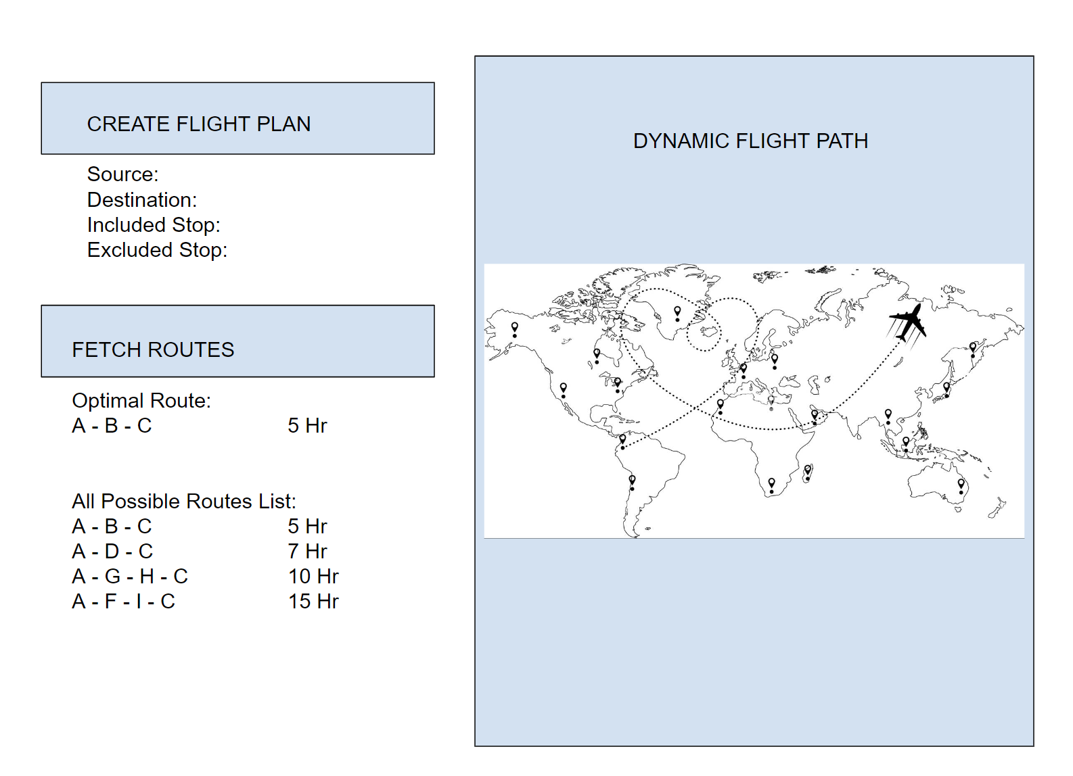
DASHBOARD
PAGE
WIREFRAME

Slide 12
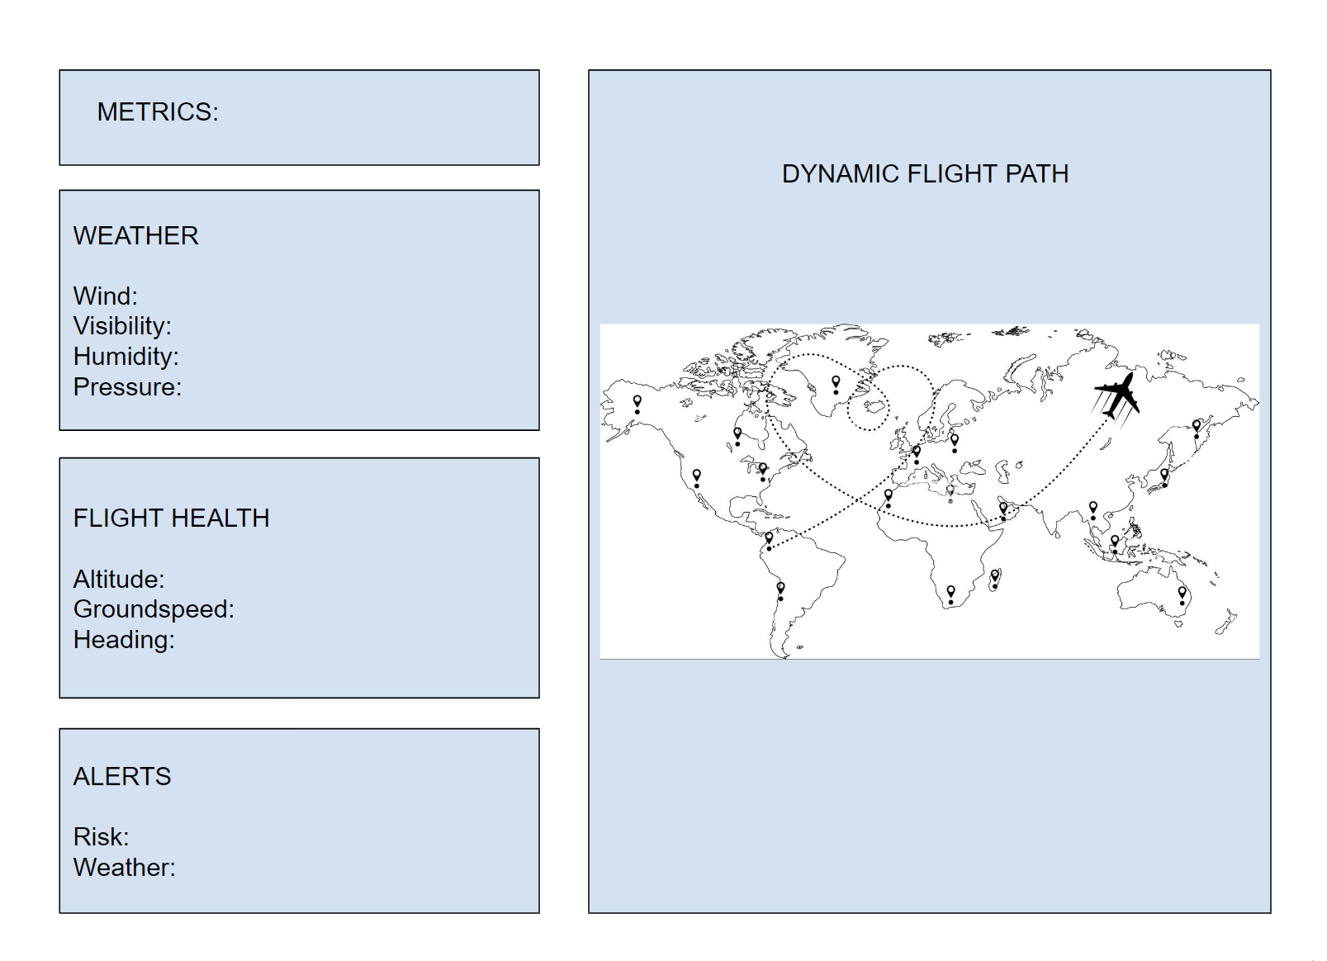
METRICS PAGE
WIREFRAME

Slide 13
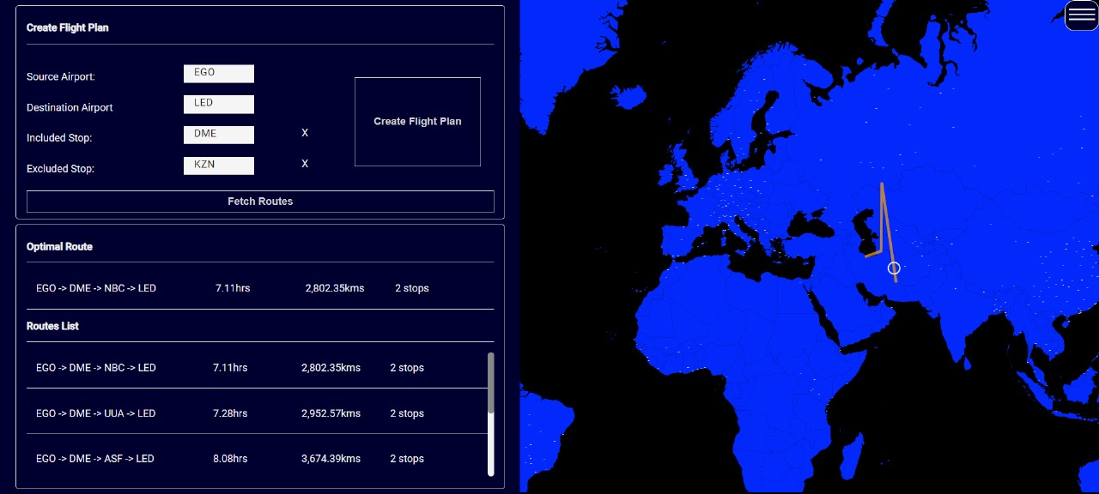
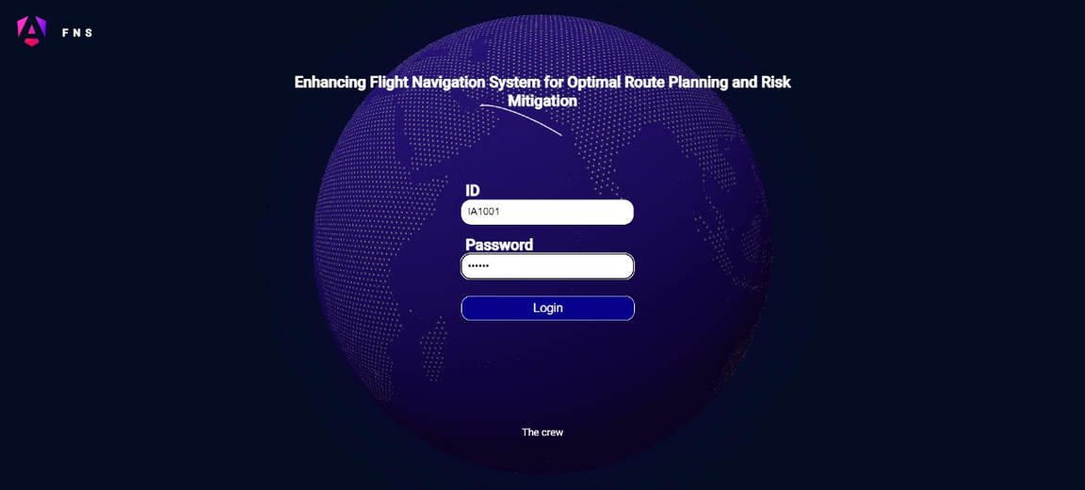

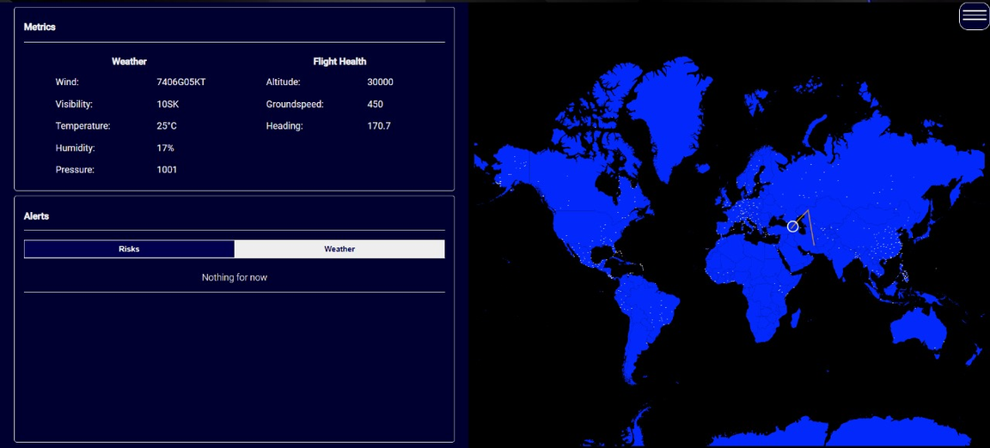
SCREENSHOTS

Slide 14
AIRBUS AEROTHON 6.0 2024
THANK YOU

